Slide 1
Web Securities & Adversarial Information Retrieval
The Manipulation of Web Content

Slide 2
What is Adversarial IR?
Gathering, Indexing, Retrieving and Ranking Information
Subset of the information has been manipulated maliciously
Financial Gain

Slide 3
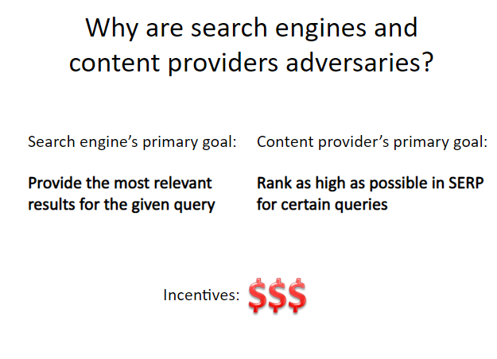

Slide 4
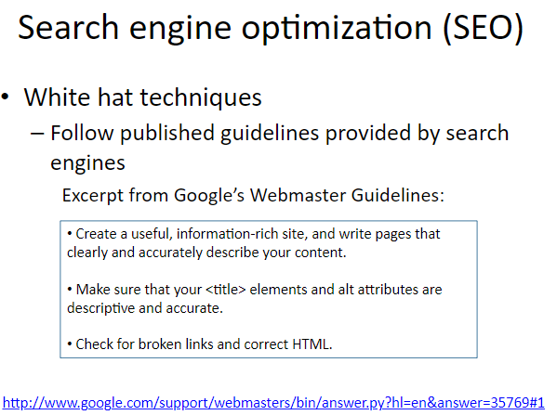

Slide 5
Web Under Cover
Content is king
Keywords
Emphasize readability:
Don’t overuse keywords
Keep sentences and paragraphs brief
Use subheadings
Visual Assets
Attractive Title Tags
Meta Description
Image Optimization
Geotagging (For Local Search)
Site Speed
Responsive Design
URL Structure

Slide 6
What is the Goal of AIR?
Detect the spam sites or communities
Improve precision on search engines by eliminating the bad webpages

Slide 7
Simplest form
First generation engines relied heavily on tf/idf
The top-ranked pages for the query maui resort were the ones containing the most maui’s and resort’s
SEOs responded with dense repetitions of chosen terms
e.g., maui resort maui resort maui resort
Often, the repetitions would be in the same color as the background of the web page
Repeated terms got indexed by crawlers
But not visible to humans on browsers
Pure word density cannot
be trusted as an IR signal

Slide 8
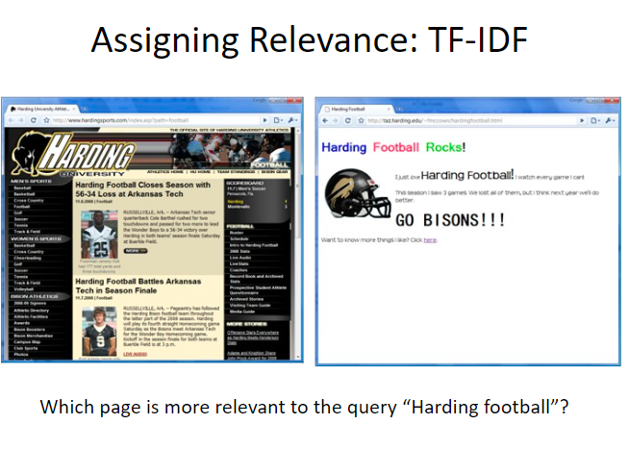

Slide 9
Search Engine Spamming
Link-spam
Link-bombing
Spam Blogs
Comment Spam
Keyword Spam
Malicious Tagging

Slide 10
Spamming
Online tutorials for “search engine persuasion techniques”
“How to boost your PageRank”
Artificial links and Web communities
Latest trend: “Google bombing”
a community of people create (genuine) links with a specific anchor text towards a specific page. Usually to make a political point

Slide 11
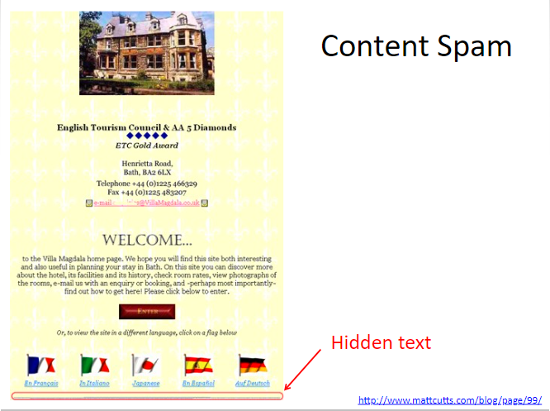

Slide 12
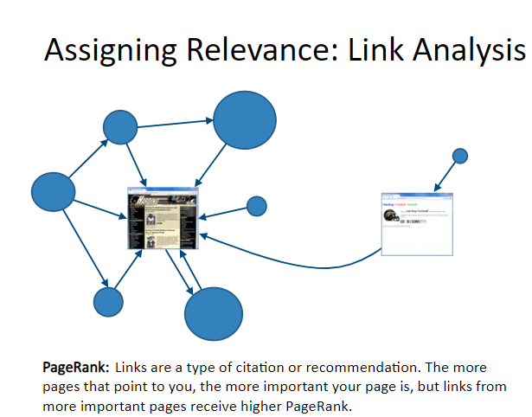

Slide 13
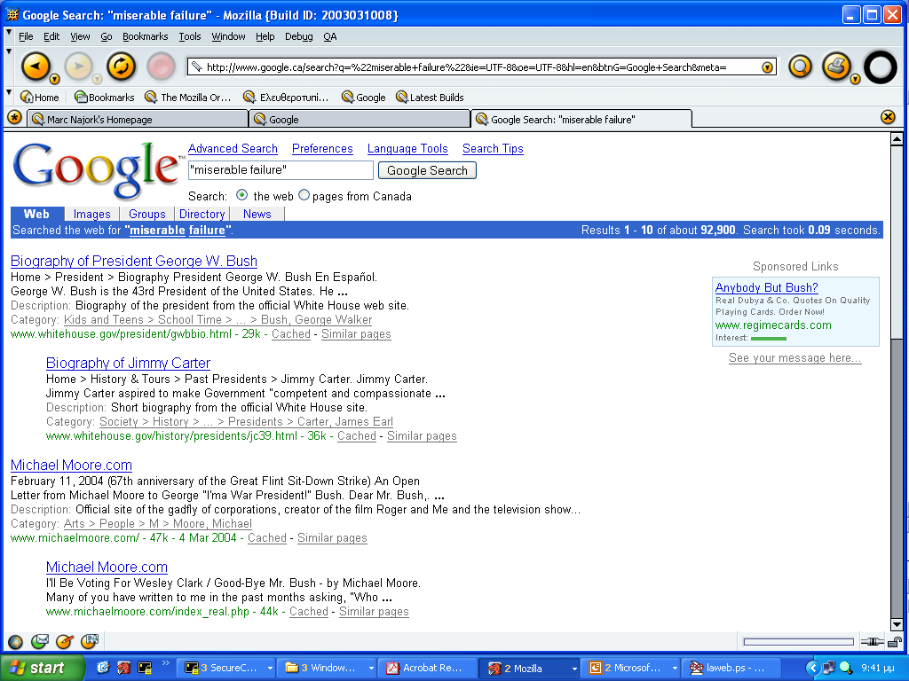
Google Bombing

Slide 14
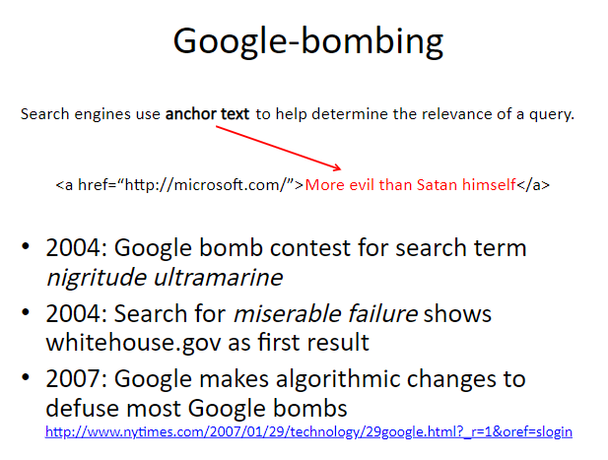

Slide 15
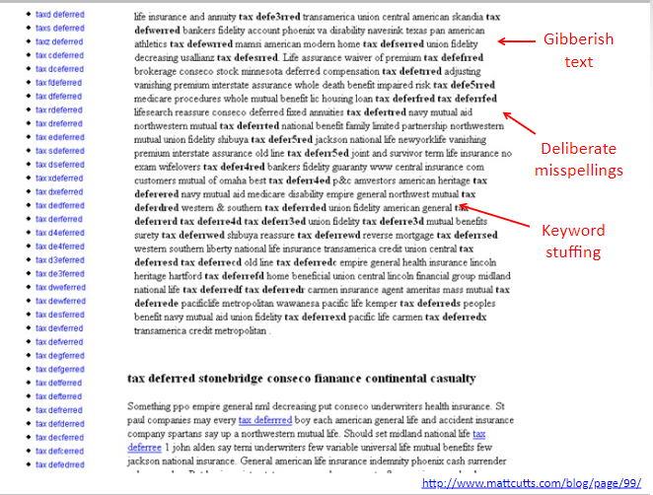

Slide 16
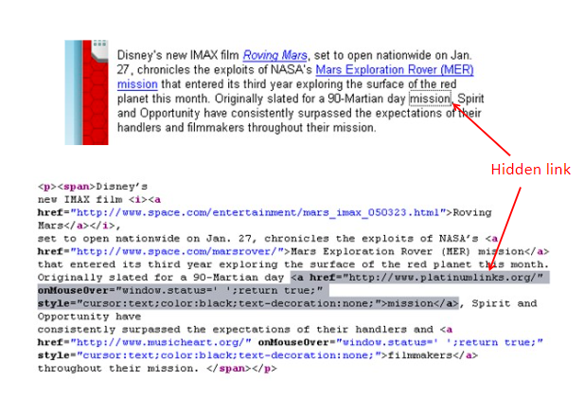

Slide 17
What is Cloaking in SEO?
Cloaking in SEO is a method used to serve users content or information that is different from what is presented to search engine crawlers (i.e. spiders or bots) to improve a website’s search engine rankings for certain keywords.

Slide 18
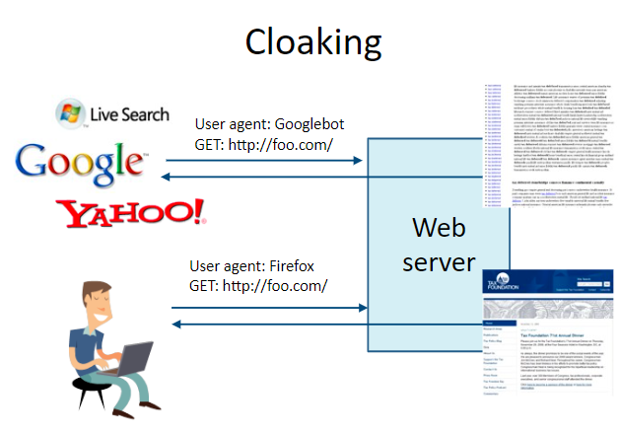

Slide 19
What are the different types of cloaking and how is it done?
User-Agent Cloaking
IP based cloaking
JavaScript cloaking
HTTP_REFERER cloaking
HTTP Accept-language header cloaking

Slide 20
1. User-Agent Cloaking:
A user-agent is a program (a software agent) that operates on behalf of a user. Example, a web browser acts as user-agent that fetches website information on an operating system. When you key in a query, the browser sends a code to the server that will distinguish/identify the user-agent. If the user-agent is identified to be a crawler, cloaked content is served.
2. IP-based cloaking:
Every user accessing a website has an IP address based on their location and internet service. In this, the users are redirected to the desired page through a page with good SERP ranking and high traffic volume. For this, you can use the reverse DNS records (available in the cPanel of your hosting company) to identify the IP address and set up .htaccess to redirect them. This is the most preferred method of cloaking.

Slide 21
3. JavaScript cloaking:
This happens when users with JavaScript-enabled browsers are served one version of the content while users who have JavaScript disabled (like search engines) are served another version of a website.
4. HTTP_REFERER cloaking:
In this method, the HTTP_REFERER header of the requester is checked and based on that, a cloaked or uncloaked version of the website is served.
5. HTTP Accept-language header cloaking:
This technique checks the HTTP Accept-Language header of the user and based on the match result, a specific version of the website is presented. In simple terms, if the HTTP Accept-Language header is of a search engine, then a cloaked version of the website is served.

Slide 22
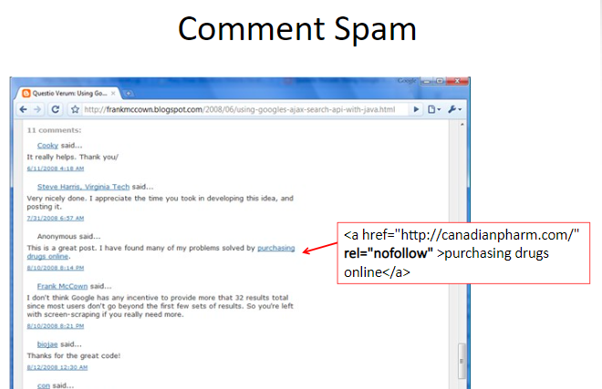

Slide 23
Web Security and Vulnerabilities

Slide 24
Most Common Website Security Vulnerabilities
SQL Injections. ...
Cross Site Scripting (XSS) ...
Broken Authentication & Session Management. ...
Insecure Direct Object References. ...
Security Misconfiguration. ...
Cross-Site Request Forgery (CSRF)

Slide 25
1. SQL INJECTIONS
SQL injection is a type of web application security vulnerability in which an attacker attempts to use application code to access or corrupt database content. If successful, this allows the attacker to create, read, update, alter, or delete data stored in the back-end database. SQL injection is one of the most prevalent types of web application security vulnerabilities.

Slide 26
SQL Injection
Example:
Look up customer details, one at a time, via customer ID.

Slide 27
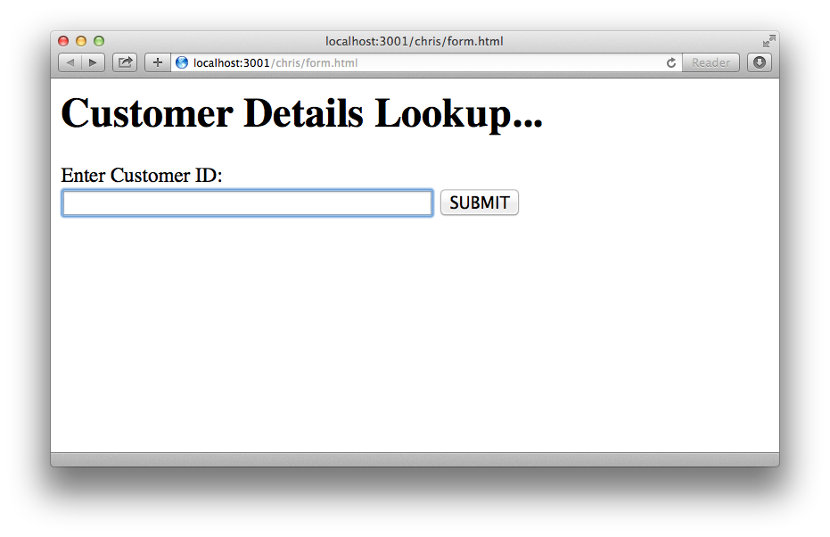

Slide 28
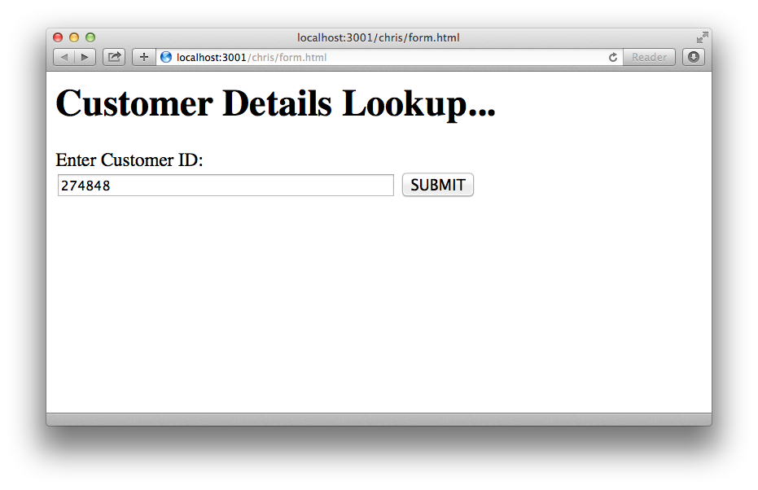

Slide 29
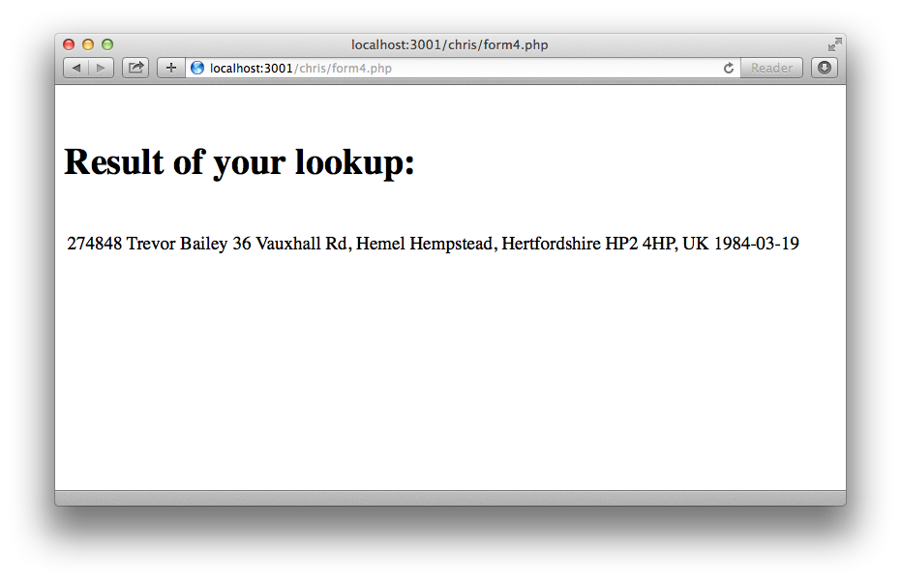

Slide 30
$mysqli= new mysqli($host,$dbuser,$dbpass, $dbname);
$id= $_POST{'id'};
# SQL query (dynamic)
$query = "SELECT * FROM cust WHERE id = $id";
$result = $mysqli->query($query);

Slide 31
SELECT * FROM cust WHERE id = 274848;

Slide 32
274848
274848 OR 1 = 1
$query = "SELECT * FROM cust WHERE id = $id ";
$query = "SELECT * FROM cust WHERE id = 274848 OR 1 = 1";

Slide 33
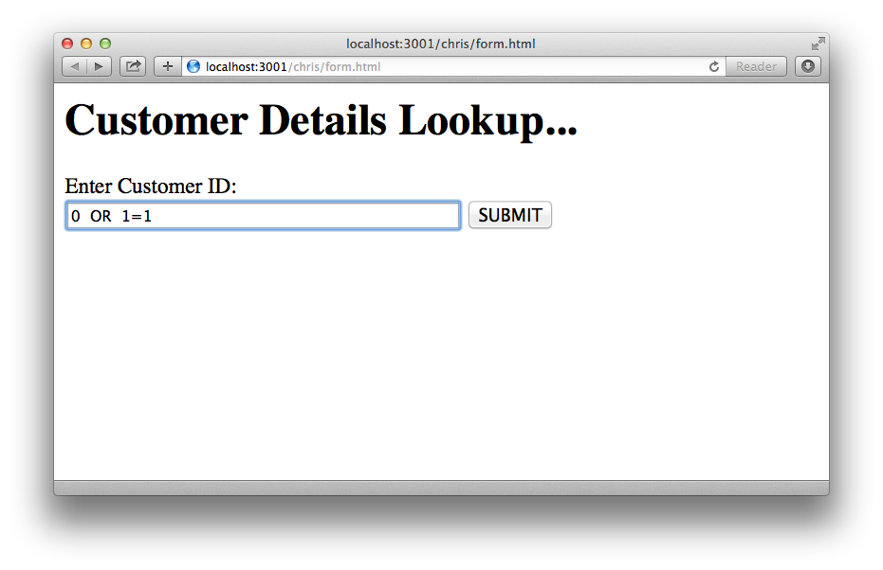

Slide 34
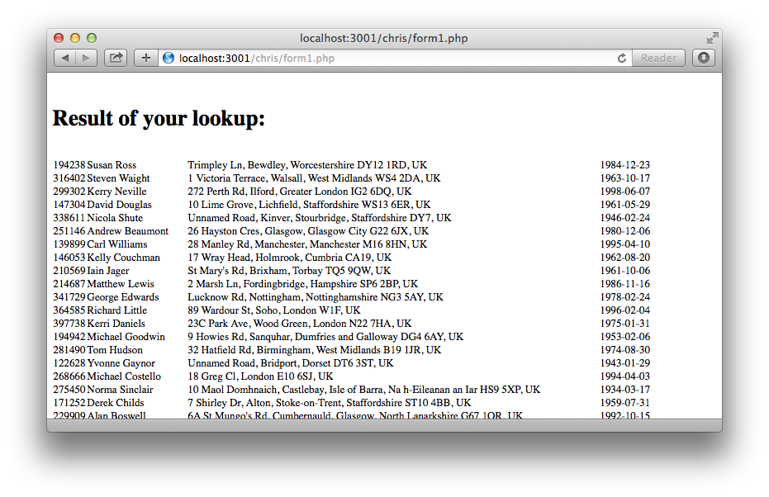

Slide 35
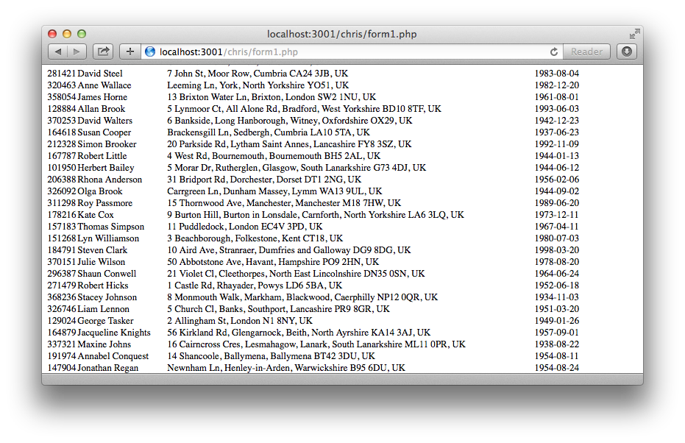

Slide 36
How to fix the code…
Sanitise untrusted inputs
Prepared Statements (with Parameterised Queries)

Slide 37
$id= $_POST{'id'};
# SQL query (dynamic - vulnerable)
$query = "SELECT * FROM cust WHERE id = $id";
$result = $mysqli->query($query);

Slide 38
How to do it right…

Slide 39
$id= $_POST{'id'};
# SQL query (prepared)
$query = "SELECT * FROM cust WHERE id = ?";
$stmt = $mysqli->prepare($query);
$stmt->bind_param(“s", $id);
$stmt->execute();
$stmt->bind_result($id, $name, $addr, $dob);

Slide 40
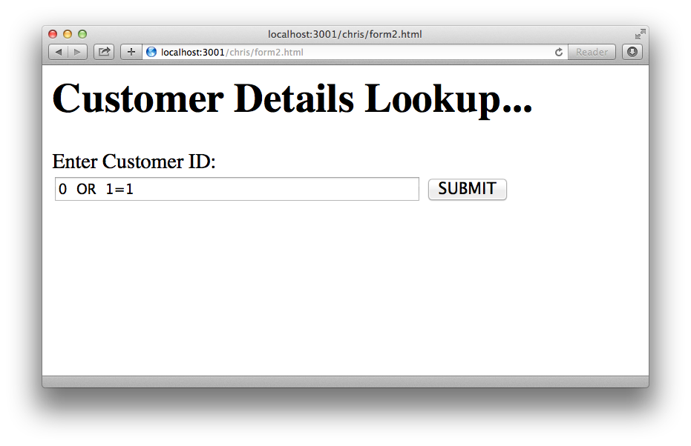

Slide 41
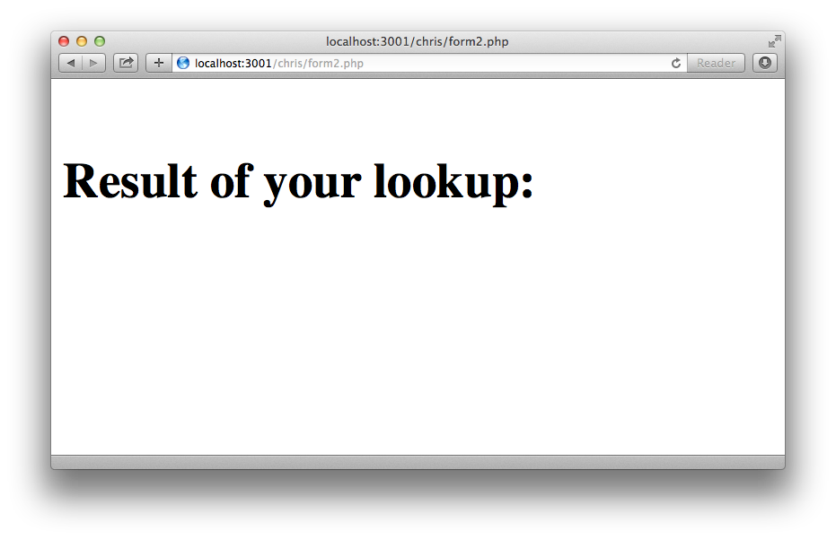

Slide 42
Authentication: knowing who an entity is // identity verification
Authorization: knowing what a given entity can do // privileges
VIT student RAJ logins (user credentials) into LMS Moodle – DBMS, Web Mining, Nosql Database - Authentication
Raj access lecture slides and other learning materials related to NoSql DB (module 2)- Privileges

Slide 43
Injection flaws:
pass unfiltered data to the SQL server (SQL injection),
to the browser
to the LDAP server (LDAP injection),
LDAP (Lightweight Directory Access Protocol) is a software protocol for enabling anyone to locate data about organizations, individuals and other resources such as files and devices in a network -- whether on the public Internet or on a corporate Intranet
or anywhere else

Slide 44
Web Security Issues
2. CROSS SITE SCRIPTING (XSS)
Cross-site scripting (XSS) targets an application's users by injecting code, usually a client-side script such as JavaScript, into a web application's output. The concept of XSS is to manipulate client-side scripts of a web application to execute in the manner desired by the attacker. XSS allows attackers to execute scripts in the victim's browser which can hijack user sessions, deface websites or redirect the user to malicious sites.
3. BROKEN AUTHENTICATION & SESSION MANAGEMENT
Broken authentication and session management encompass several security issues, all of them having to do with maintaining the identity of a user. If authentication credentials and session identifiers are not protected at all times, an attacker can hijack an active session and assume the identity of a user.

Slide 45
www.doll.com/module1/
4. INSECURE DIRECT OBJECT REFERENCES
Insecure direct object reference is when a web application exposes a reference to an internal implementation object. Internal implementation objects include files, database records, directories and database keys. When an application exposes a reference to one of these objects in a URL, hackers can manipulate it to gain access to a user's personal data.
5. SECURITY MISCONFIGURATION
Security misconfiguration encompasses several types of vulnerabilities all centered on a lack of maintenance or a lack of attention to the web application configuration. A secure configuration must be defined and deployed for the application, frameworks, application server, web server, database server and platform. Security misconfiguration gives hackers access to private data or features and can result in a complete system compromise.

Slide 46
6. CROSS-SITE REQUEST FORGERY (CSRF)
Cross-Site Request Forgery (CSRF) is a malicious attack where a user is tricked into performing an action he or she didn't intend to do. A third-party website will send a request to a web application that a user is already authenticated against (e.g. their bank). The attacker can then access functionality via the victim's already authenticated browser. Targets include web applications like social media, in browser email clients, online banking, and web interfaces for network devices.
Don't get caught with your guard down. Practice safe website security measures and always be ready to protect yourself, and your company's future, from an attack that you might never recover from. The best way to tell if your website or server is vulnerable is to conduct regular security audits.

Slide 47
Broken Authentication
session id leak
passwords not encrypted
session ids predictable
Session fixation
Session hijacking
Cross Site Scripting (XSS)
JavaScript tags on input

Slide 48
Insecure Direct Object References
direct object reference: internal object such as a file or database key
Security misconfiguration
application with debug enabled
directory listing enabled on the server
Running outdated software
unnecessary services running on the machine
Not changing default keys and passwords
Revealing error handling information such as stack traces

Slide 49
Sensitive data exposure
crypto and resource protection
Missing function level access control
authorization failure
Cross Site Request Forgery (CSRF)
browser is fooled by some other party into misusing its authority

Slide 50
Using components with known vulnerabilities
maintenance/deployment issue
Unvalidated redirects and forwards
input filtering issue

Slide 51
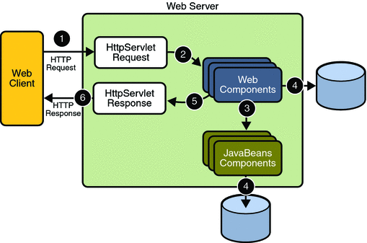
Java Web Security

Slide 52
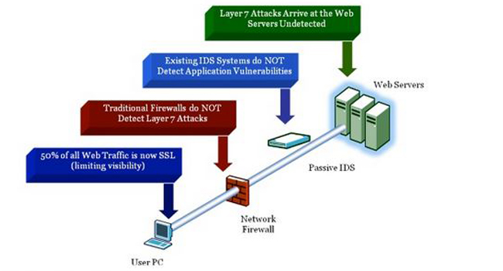

Slide 53
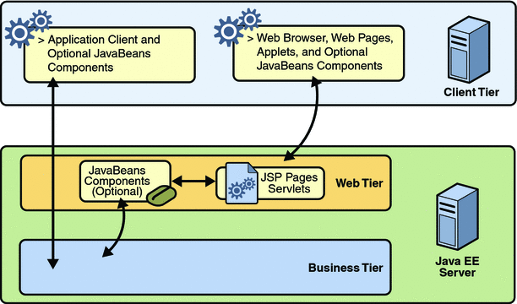

Slide 54
